Slide 1
Revision

Slide 2
Structured data
Determine Y Categorical (classifier, accuracy) or Continuous (Regressor,rmse)
Data Clean?
(yes, use Kbest to select feature, else correlation. If features not many, then take all)
Data Visualization (describe, histogram, botplot, seaborn catplot heatmap, matplotlib scattered plot)
Outlier (removed)
Categorical input? Dummy variables
Split Train Test
Balance Data (oversampling the minority)
Normalization (Z)
Machine Learning Model – Regression, Tree, NN
Results – Categorical – confusion matrix, accuracy, ROC, Continuous - RMSE
Limitation – Regression (VIF, QQ, Anova), Tree (Optimizer – Max depth, min split), NN (Optimizer – Learning rate, epoch)
Front end (html), back end (flask), cloud (Heroku & Github)

Slide 3
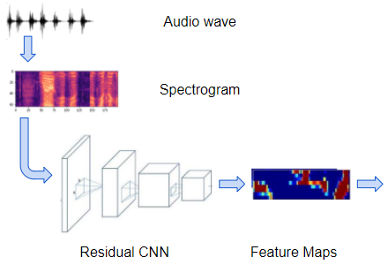
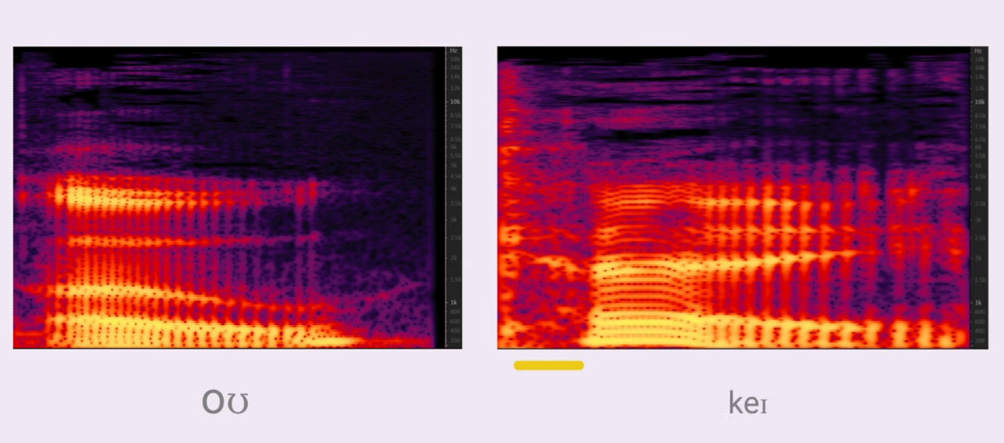
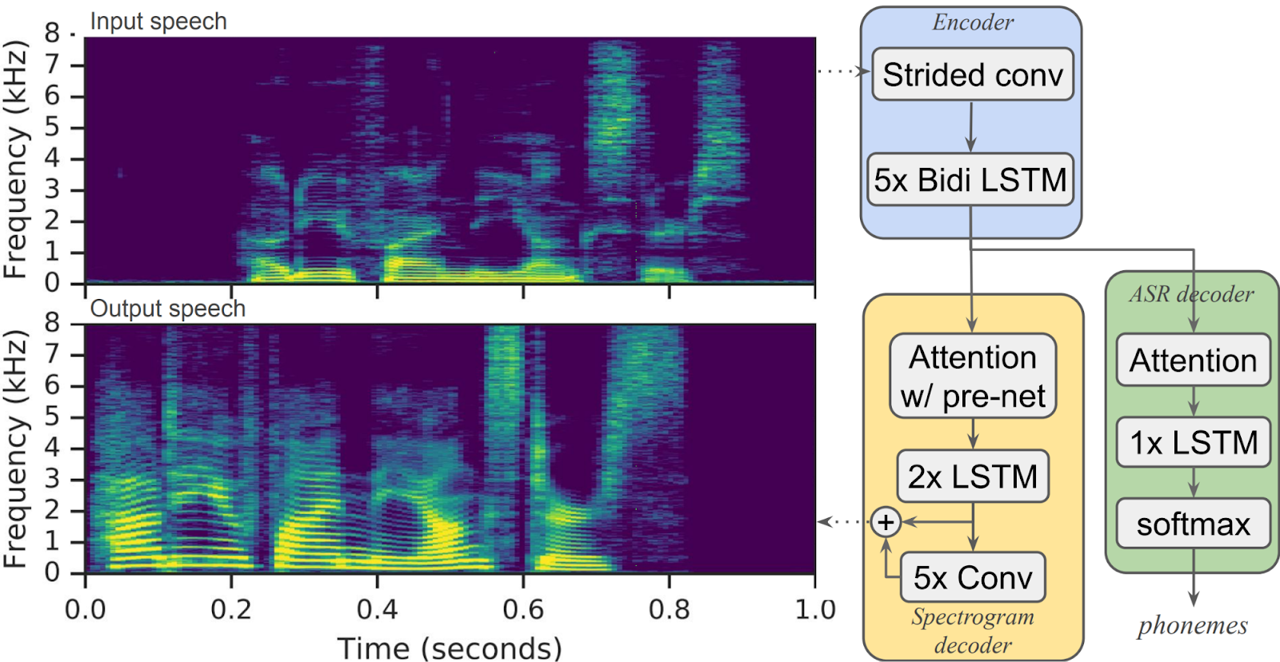
Speech
spectrogram

Slide 4
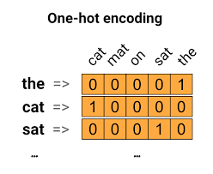
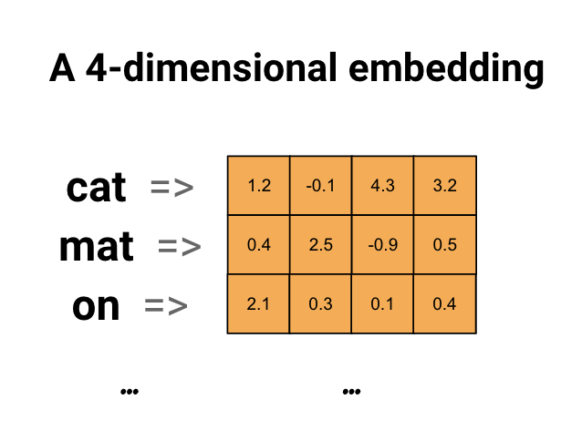
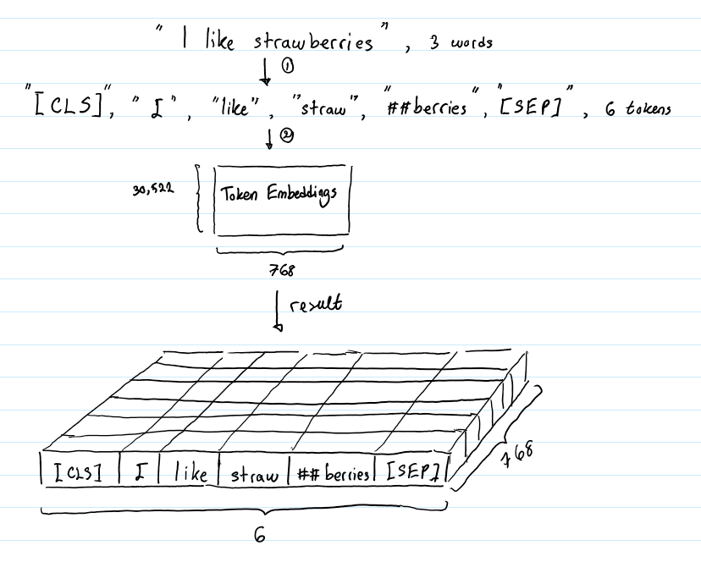
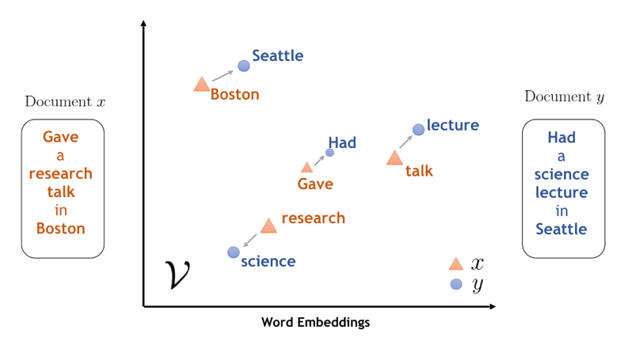
Text

Slide 5
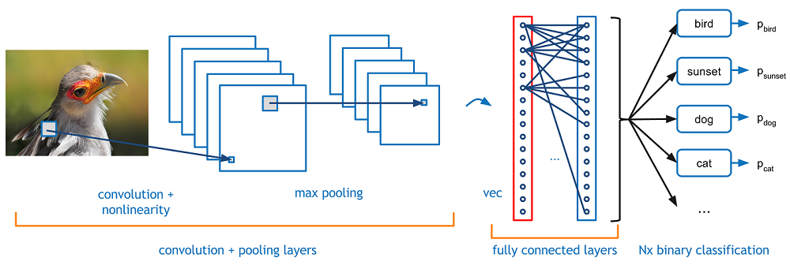
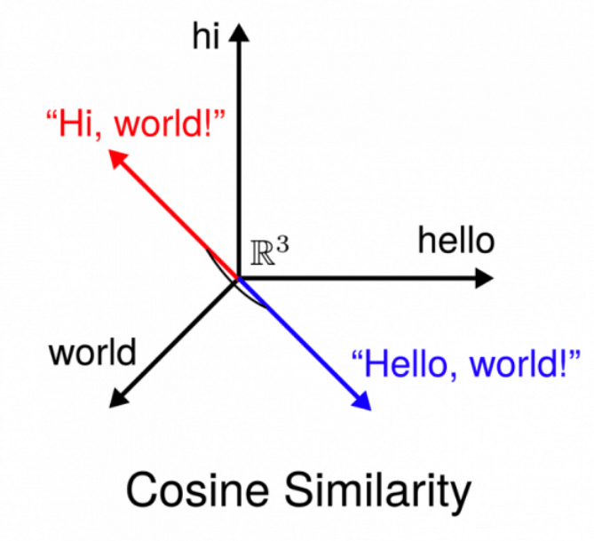
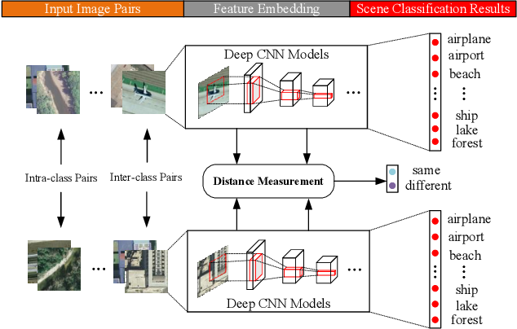
Image

